Slide 1
HAVE YOU GOT WHAT
IT TAKES TO BE AN ARKWRIGHT ENGINEERING SCHOLAR?

Slide 2
ARKWRIGHT ENGINEERING SCHOLARSHIPS
We were established as a trust in 1991, and merged with The Smallpeice Trust on 4th January 2018. We operate across the UK, Channel Islands & Isle of Man.
Our Mission:
To Inspire Future Leaders in Engineering.
Our Focus:
Engineering: Wide definition including technical design, construction, chemicals, software and computing.
High-calibre students destined to go to university or into a higher apprenticeship and take a ‘leadership’ role in engineering or technical design.

Slide 3
WHAT IS AN ARKWRIGHT
ENGINEERING SCHOLARSHIP?
Through enrichment and mentoring, supports & encourages you to do well in your A levels / Scottish Advanced Highers.
Helps you to explore engineering & technical design.
Helps you to decide if a degree or higher apprenticeship and a career in these subjects are for you.

Slide 4
HOW DO I GET A SCHOLARSHIP?
You must be in the right school year
Year 11 (England & Wales)
S4 (Scotland)
Year 12 (Northern Ireland)
A competitive application process
Online application form with teacher reference by mid January 2023
Two-hour aptitude exam in February 2023
Virtual interview in April 2023
If successful, matching to a Sponsor June to September 2023
Awards Ceremony in October 2023

Slide 5
THE ONLINE
APPLICATION FORM
Very important – it is part of our assessment and is marked. Tell us about:
Your career aspirations in Engineering or technical design
A practical project you have done
Your social and school activities that show your leadership potential and, separately, your interest in engineering or technical design
Usually accompanied by a teacher’s reference about you.

Slide 6
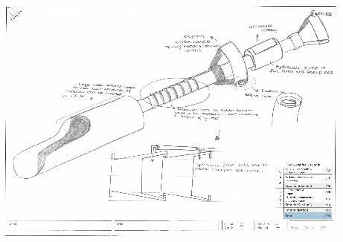
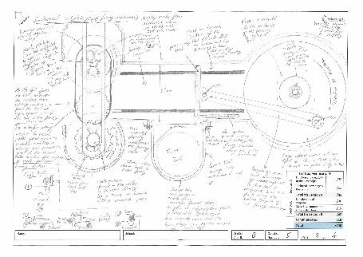
THE APTITUDE
EXAM
Two hours, sat under exam conditions in your school
Section A – explore diverse & interesting solutions to the set engineering problems – practice thinking outside the box
Section B - design a solution to an engineering problem in greater detail - practice describing how and why products are constructed

Slide 7
THE
INTERVIEW
A virtual 30 minute interview
Two interviewers
Talk about
your practical project(s)
your extra-curricular interests
your leadership experience
your future aspirations in engineering

Slide 8
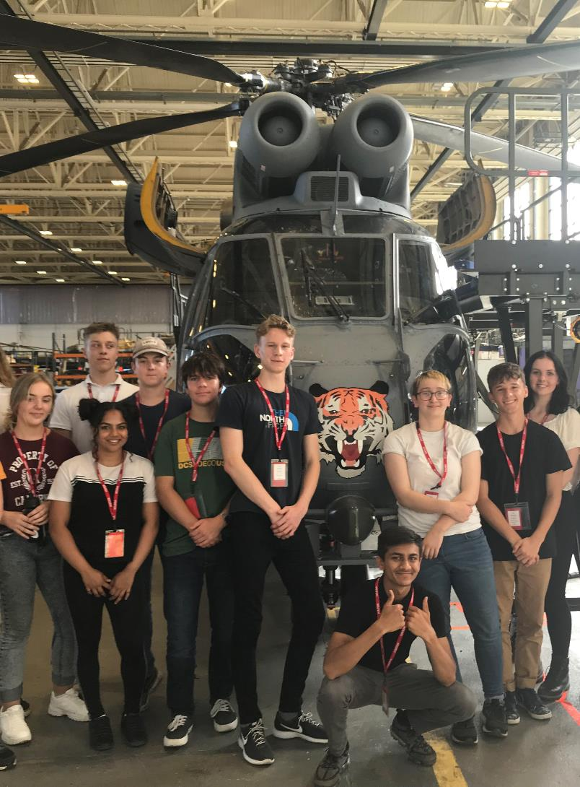
WHAT DO I GET FROM
A SCHOLARSHIP?
Financial Support
Industry Connect Days
Mentoring
Networking
Quarterly newsletter packed full of information and events
A highly-respected Scholarship to go on your university or higher apprenticeship applications - get noticed!

Slide 9
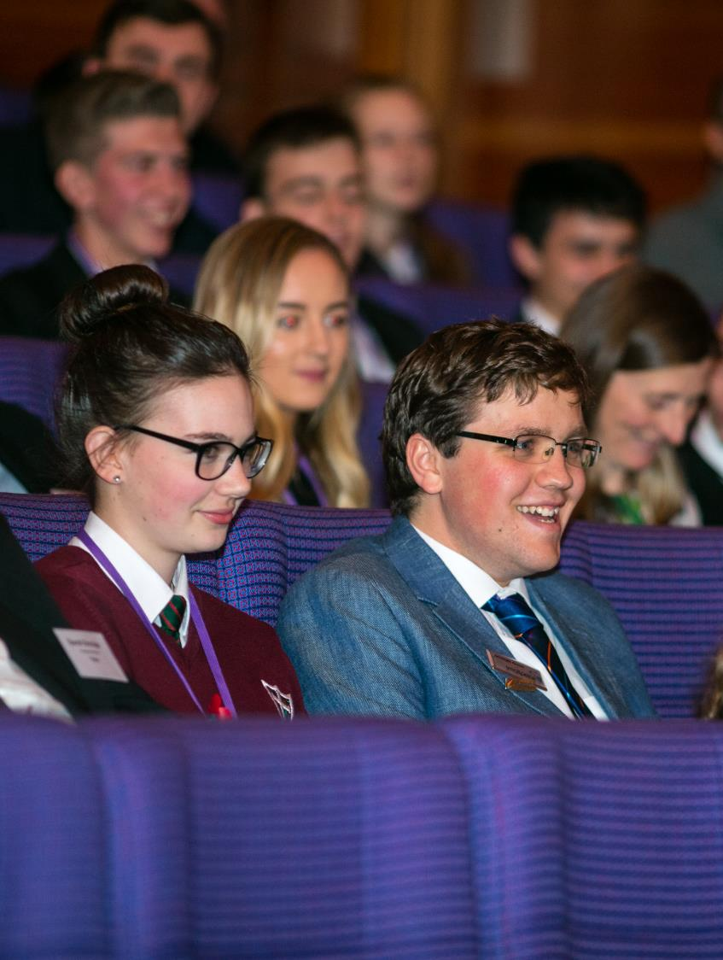
LONGER-TERM
BENEFITS
Exclusive university undergraduate Scholarships
Alumni activities including job opportunities with our Sponsors
Powerful Alumni group (Almost 7000 Engineers)
Once you are in a career – further personal development opportunities…
Become an Arkwright Mentor – providing invaluable first-hand knowledge, support and inspiration to our Scholars throughout their two-year Scholarship
Help with the Arkwright Selection Process as an Interviewer

Slide 10
DOES IT HELP
MY SCHOOL?
Financial support for your school
Winning prestigious Arkwright Engineering Scholarships helps to:
motivate & reward high-calibre students as they enter the 6th Form
raise the supporting Department’s profile within the school
raise the whole school’s profile nationally
provides the school with valuable marketing opportunities to prospective parents
All this through a scheme that has a low time commitment on teachers and costs just £40 per student application

Slide 11
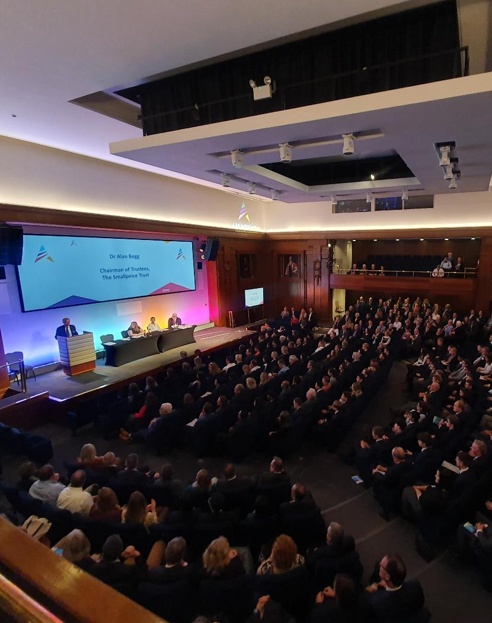
WHERE DO
I START?
Talk to the Arkwright coordinator in your school as soon as you can. If they think you are a suitable candidate they will guide your application.
To apply, students must be:
Attending an Arkwright-affiliated School
In Year 11 (England & Wales), S4 (Scotland), year 12 (Northern Ireland)
Taking GCSEs/Scottish National 5s/BTECs level 2/IB Middle Years Programme relevant to engineering or technical design
Making a commitment to Maths to A2 / Advanced Higher / IB Diploma Higher
Planning to take A levels/Scottish Highers/BTECs Level 3/IB Diploma appropriate to a higher apprenticeship or university study in Engineering or technical aspects of Design
Actively considering a career in engineering or technical design

Slide 12
WHAT PEOPLE
SAY…
“Arkwright helped me achieve my dream of being an Engineer. Transforming me from a young girl who lacked self-confidence, to the competent Engineer I am today.” Yin Ki (Kiki) Fong, Engineer, Atkins Arkwright Engineering Scholar 2006
“My Arkwright experience has been invaluable; giving me the platform to excel in my industry. Now, 10 years later, my involvement as an Arkwright Mentor has enabled me to share the opportunity with other future engineers.” Jake Goldsmith, Project Engineer, Hitachi Rail Arkwright Engineering Scholar 2008
“Arkwright has given me the confidence to seek out new technical and leadership opportunities for myself, and shown me how I can now open these doors for other young engineers.” Lucy Bell, Technology Degree Apprentice, PwC - Arkwright Engineering Scholar 2017 & Arkwright Undergraduate Engineering Scholar 2019
“I often look back over the past 8 years and trace many of the best opportunities I have had having been started by Arkwright in some way or another.” Max Munford, Medical Engineer, Imperial College London - Arkwright Engineering Scholar 2012

Slide 13
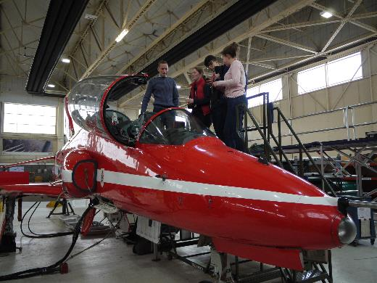
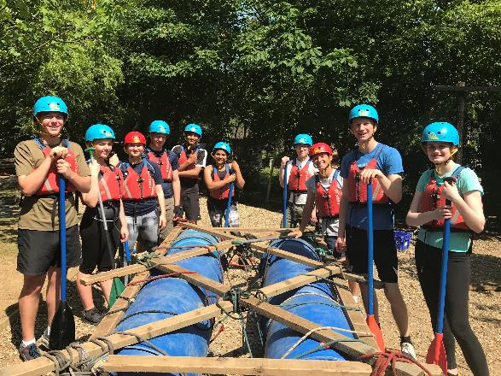
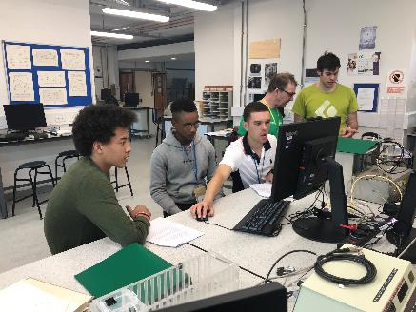
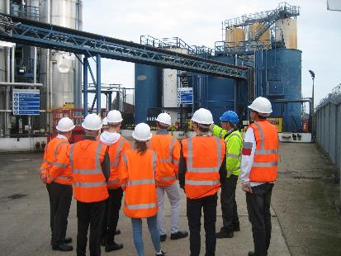
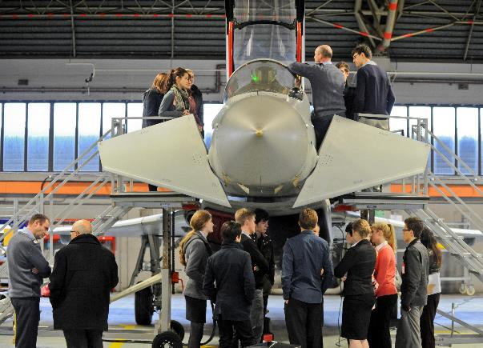
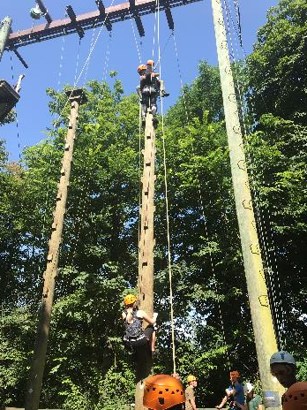
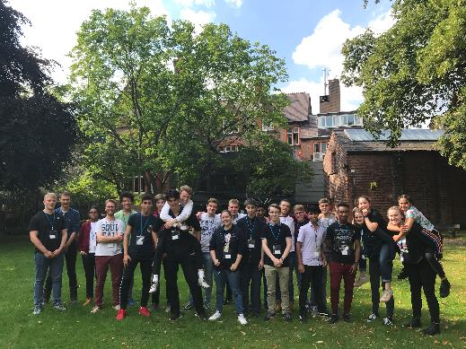
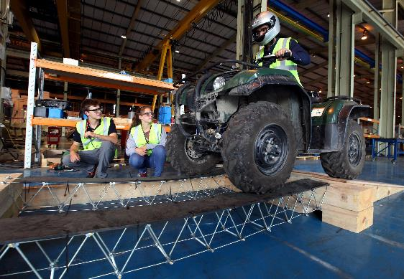
ENRICHMENT
OPPORTUNITIES

Slide 14
IT’S TIME TO
TAKE ACTION
Opportunities like this are life-defining. It all starts with you, so be bold, and take the first steps.
For more information about the process of becoming an Arkwright Engineering Scholar, or to find out more about us and how we can help you tackle your engineering ambitions, visit www.arkwright.org.uk or call 01926 333210.
Facebook @ArkwrightEngScholarships
Twitter @ArkwrightTalent
Instagram @ArkwrightScholarships

